Slide 1
Admin stuff
A1 will be available tonight. Deadline is May 29st 5pm
No push access after this date
Submit your assignment on Gradescope.ca by linking it to your Github

Slide 2
CSCC09 Programming on the Web
Interactive frontends with JavaScript
Cho Yin Yong

Slide 3
Last Lecture
Create a professional page layout with HTML/CSS with 12-column layout
Learn how to make websites responsive

Slide 4
Javascript
Dynamic and weakly typed (typescript kind of fixes that)
Interpreted, Just-in-time (JIT) compiled programming language (more on that in CSCC24)
First class functions (functions are variables)

Slide 5
Use the latest version of javascript - es2020
The last big change to Javascript was ES6
https://caniuse.com/?search=es6
https://caniuse.com/?search=es5
Always learn the latest - people always make tools to compile es6 code to es5.

Slide 6
Basic Syntax
// this is a comment
/*
* this is a
* multiline comment
*/
console.log(‘Hello world’)
console.warn(‘Houston, we have a problem’)

Slide 7
Useful Primitives (immutable)
const a = ‘hello’ // string
const b = 10 // number
let c = true // boolean
const d = undefined
const e = null

Slide 8
Arrays (mutable)
const myArray = [1, 2, 3, 4]
myArray[0] // 1

Slide 9
Objects (mutable)
const myObject = {
firstName: “Cho Yin”,
}
myObject.lastName = “Yong”

Slide 10
If-else statements
if (myCondition && myOtherCondition) {
// do something
} else if (myCondition || anotherCondition) {
// do something else
} else {
// do something else
}

Slide 11
Functions
function myFunctionName(myParam) {
}

Slide 12
Array manipulation - useful for lab and assignment!
const myArray = [1, 2, 3]
myArray.push(4)
myArray.splice(1, 1)
console.log(myArray)

Slide 13
Anonymous/Arrow Functions
const myFunction = function() {}
const myOtherFunction = (myParam) => {}
const result = myFunction()

Slide 14
const and let
var x = 0 // old syntax, don’t use this
const a = 0
a = 1 // ERROR
let b = 0
b = 1 // OK
When to use const vs when to use let?

Slide 15
Functions can be variables
const a = [1, 2, 3, 4]
a.forEach((element) => {
console.log(element);
})
const b = a.map((e) => {
return e + 1;
})

Slide 16
Functions can be variables
function forEach(array, fn) {
for (let i = 0; i < array.length; i++) {
// the function is called for each item in array
fn(array[i]);
}
}
forEach([1, 2, 3, 4], (e) => console.log(e))

Slide 17
Functions can be variables
function map(array, fn) {
const output = [];
for (let i = 0; i < array.length; i++) {
output.push(fn(array[i]));
}
return output;
}

Slide 18
Tricks
Use optional chaining operator on if statements to simplify: if (item?.attr) vs if (item && item.attr)
To convert a string into an int, you can do +'5'
When checking for null or undefined, use Nullish coalescing operator (??)

Slide 19
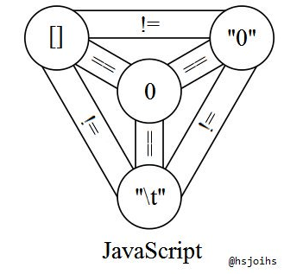
Don’ts
The Javascript holy trinity
Double equals (==)
Use triple equals almost always (===)
== will convert variable values to the same type before comparison.

Slide 20
More JavaScript help
https://developer.mozilla.org/en-US/docs/Web/JavaScript
Github Copilot Chat

Slide 21
Javascript in the Browser

Slide 22
JavaScript in the browser
Event-driven programming model
Execution flow determined on events that happen on the browser
Updates a page via the “Document Object Model”
No access to other programs
Cannot execute arbitrary OS commands
Cannot access other tabs
No access to filesystem (only upload forms) new!

Slide 23
Including javascript
Inline
<button onclick="console.log(‘hello world’)">
Embedded: specified in the header (<head>)
<script type="text/javascript">
console.log(‘hello world’)
</style>
Separate file: at the end of the body
<script src=”js/main.js”/>
Rule specific for C09 vanilla JS. Each “framework” has its own rules - should respect that.

Slide 24
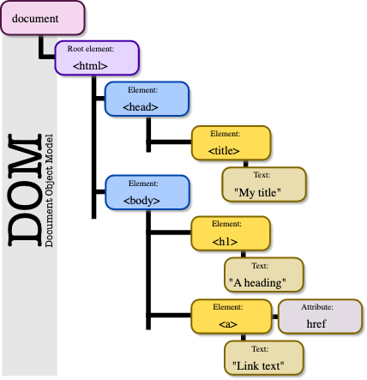
Document Object Model
Tree representation of an HTML document, accessible via Javascript
Add, change, remove any HTML elements and attributes
Change any CSS styles

Slide 25
DOM Node accessors - selecting DOM element
document.getElementById("id")
document.getElementByTagName("p");
document.getElementByClassName("class");
document.querySelector("#username"); # preferred
document.querySelectorAll(".dropdown .dropdown-item"); # preferred
document.querySelector(".dropdown .dropdown-item"); # problem

Slide 26
DOM Methods (for element x) - Updating
x.innerHTML | The HTML inside of x
x.content | The content inside of x
x.attributes | The attributes of x
x.style | Css of x
x.append(element), x.prepend(element) | prepend/append element to x
x.appendChild | Insert a child node to x
x.removeChild | Remove a child node from x
document.createElement('div') | Create a div
We will not use this

Slide 27
Web Events
Events that are built into the browser
Anything that you can think of
https://developer.mozilla.org/en-US/docs/Web/Events
document.querySelector("#dontClickMe").addEventListener("click", function() {
alert("You clicked me!");
});

Slide 28
Global variables!
window | The current browser window
history | Browser back and forward URLs
localStorage/sessionStorage | A simple browser persistent storage API
document | To access the DOM

Slide 29
setTimeout, setInterval
setTimeout: Run something after x milliseconds.
setInterval: Run something every x milliseconds.
setTimeout(function() {}, 1000)

Slide 30
Good browser Javascript practices

Slide 31
Strict mode: “use strict”
Force the browser to validate Javascript against the standard
Dynamically raises errors (or warnings) in the console when the code is not compliant with the standard
Example…

Slide 32
Scoping Problem
In the browser, all Javascript files share the same execution environment i.e they share the same scope.
Naming conflicts
Unintended side consequences to event listeners
<script src=”js/one.js”/>
<script src=”js/two.js”/>
<script src=”js/three.js”/>

Slide 33
Scoping Problem
function getChirps() {
return []
}
// somewhere later in the file
getChirps()
one.js
function getChirps() {
return [{“content”: “hello world”}]
}
two.js
getChirps()
three.js
What gets called?

Slide 34
Closure: encapsulate and export the namespace
const apiService = (function() {
"use strict";
const module = {};
module.getChirps = function() {}
function privateFunction() {}
return module;
}());
Example usage:
apiService.getChirps()

Slide 35
(function() {
function getChirps() {}
})();

Slide 36
Encapsulate and add some private functions
const $ = (function() {
"use strict";
let module = {}
function myFunction() {}
return module;
}());
Example usage:
$.myFunction() <- this will throw an error

Slide 37
DOM takes time to load
If the DOM has not loaded, you are attaching event listeners to nothing…
window.onload = function() {}
window.addEventListener('DOMContentLoaded', (event) => {});
Both can be used, but what is the difference between the above?

Slide 38
Quick Chirper example
Create “chirps” and append them to the DOM.

Slide 39
Structuring browser JavaScript code

Slide 40
index1.js
Imperative programming.
When an event happens (on submission of HTML form), perform some updates directly to the DOM.
The DOM forms a source of truth of the information. We direct manipulate the UI.
This is a common pattern 10 years ago with jQuery.

Slide 41
index2.js
Taking out business logic to another file to keep separation of concerns. (i.e. separate manipulation of UI with keeping track of items)

Slide 42
Model-View-Viewmodel (MVVM)
Model: Frontend API Service (api-service.js)
ViewModel: Frontend Controller (index2.js)
View: View (index.html)
DOM bindings
View
(HTML)
ViewModel
Model
presentation
Presentation logic
Business logic & data

Slide 43
Key Concepts
The View does not know the existence of the Model
The API Service does not know the existence of anything else
The Controller is the piece that links both elements together. Controller never stores data.

Slide 44
index3.js
Manage application state using “global variables”. Use global variables as the source of truth to re-render UI always.
Idea: if we keep global variables up to date, the UI will reflect the variables always.
state.chirps.find((c) => c.id === chirp.id).content = formProps.chirp;
updateChirpList();
const state = {
chirps: [],
};
ChirpService.addChirp(formProps.chirp);
state.chirps = ChirpService.getChirps();
updateChirpList();
state.chirps.forEach(function (chirp) {
const newChirp = createChirpComponent(chirp);
document.querySelector("#chirpsList").prepend(newChirp);
});

Slide 45
index3.js
Use of event listeners (observer pattern)
const onEditButtonClickedListeners = [];
newChirp.querySelector(".edit").addEventListener("click", function () {
// show edit form of the current ChirpComponent
onEditButtonClickedListeners.push((chirpId) => {
if (chirpId !== chirp.id) {
// hide edit form of the current ChirpComponent
}
});
onEditButtonClickedListeners.forEach((listener) => listener(chirp.id));
});

Slide 46
index4.js / meact.js
An attempt to use vanilla JS to replicate basic building blocks of React.
useState()
useEffect()
What to look out for:
Implementation of Observer pattern

Slide 47
Chrome Devtools Demos
console
debugger

Slide 48
JSON

Slide 49
JSON - Javascript Object Notation
Serializes a Javascript object into a string format
Deserializes into a Javascript object

Slide 50
Breaking down “JSON”
A “Valid JSON value” is a recursive structure:
string (eg. “cscc09”, “is”, “awesome”)
number (eg. 1, 2, 42, 69)
boolean (true, false)
array of “Valid JSON values”
object of string to “Valid JSON values”

Slide 51
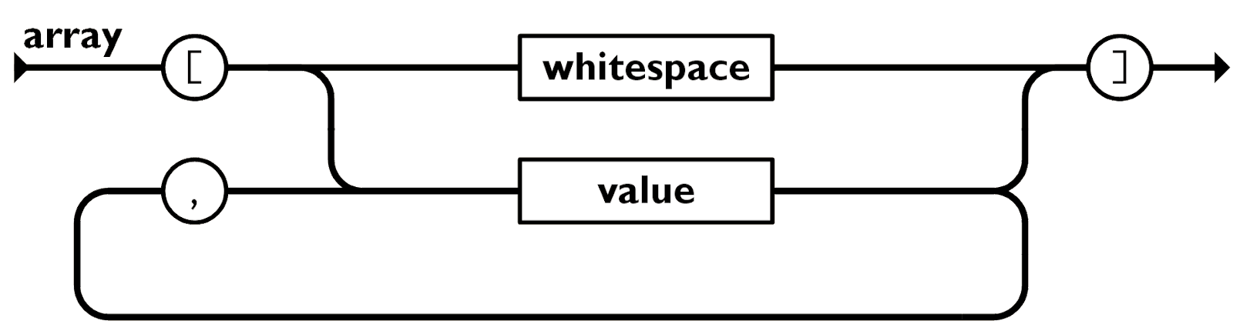
Array
An indexed list.
Eg. [1, 2, 3, true, false]
Eg. [“cscc09”, 42]

Slide 52
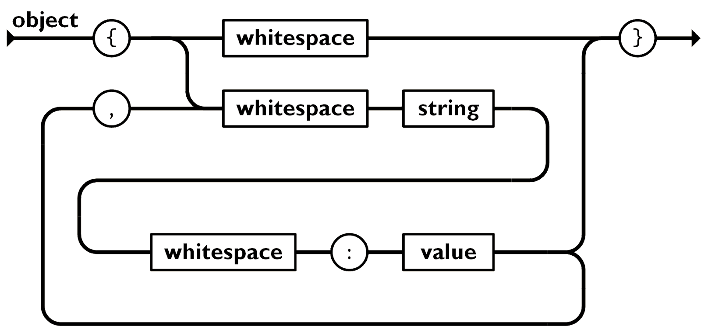
Object (key value pairs)
Eg.
{
“first_name”: “Donald”,
“last_name”: “Trump”,
“age”: 77,
“notably_positive_features”: []
}

Slide 53
Why do we care?
localStorage can only handle strings and numbers, not objects or arrays.
Serialize: JSON.stringify(obj)
Deserialize: JSON.parse(jsonStr)

